Slide 1
When does closing Hormuz break the world's economy?
CITS4403 COMPUTATIONAL MODELLING · PROJECT DEMO
A three-layer network model of the 2026 Strait of Hormuz closure
Raed Rahmanseresht · 21016839
github.com/raed-ra/cits4403-oil-chokepoint
Notes:
Hi, I'm Raed. My project models the 2026 closure of the Strait of Hormuz as a network. The question is simple: how much of Hormuz has to close before a local oil shortage turns into a breakdown of a region's economy, and what is the best way to push that point back? I'll go through the problem, the questions, how the model works, then one slide per answer. About 10 minutes.

Slide 2
One strait, a fifth of the world's oil
THE SYSTEM
20.9
4.9
$69→$105
million barrels a day normally pass Hormuz — about 1 in 5 barrels used worldwide
still flowing in Q2 2026 — the strait was 77% blocked
Brent price per barrel, February to Q2 2026
It is a complex system: oil reroutes, regions compete for cargoes, prices rise, and shortages spread from one industry to the next.
Sources: EIA (2024, 2026), IEA (2026) · CITS4403 · 2
Notes:
Hormuz normally carries about 21 million barrels a day, roughly a fifth of world oil use. In 2026 it closed: by the second quarter only about 4.9 was getting through, so it was 77% blocked, and Brent went from $69 to around $105. This is a complex system, not a subtraction: oil looks for other routes, regions compete for what's left, prices move, and a shortage in transport spreads to the industries that depend on it. That's why I modelled it as a network.

Slide 3
Six questions the model answers
RESEARCH QUESTIONS
Q1 | Is there a closure level where a local shortage turns into economic breakdown?
Q2 | Which fix pushes that level back most — bypass pipelines, using less oil, or emergency reserves?
Q3 | Does closing a second strait (Bab el-Mandeb) make it worse?
Q4 | Does it matter where the emergency reserves are stored?
Q5 | Is the network fragile because of its shape, or because of how much it carries?
Q6 | Extension: what changes when high prices make people buy less?
CITS4403 · 3
Notes:
These are the six questions. Q1 is the main one: is there a tipping point? Q2 compares three fixes. Q3 asks about a second strait closing at the same time. Q4 is about where emergency reserves sit. Q5 uses the network models from lectures 2 and 3 to ask if the problem is the network's shape or its capacity. Q6 is my extension, where high prices feed back into demand. The rest of the talk answers them in this order.

Slide 4
Each 2026 study models one piece; mine joins them
WHAT IS NEW
 | An et al. May 2026 | Devetak et al. June 2026 | Sharma & Lau May 2026 | Hinz et al. March 2026 | This project Oct 2026
Hormuz closure | Yes | Yes | Yes (India) | Yes | Yes
Model type | Daily simulation | Ship agents | Optimisation | Equilibrium | Daily simulation
Oil reroutes | No | Yes | Yes | No | Yes
Industry domino effect | Yes | No | No | Yes | Yes
Regional reserves | No | No | Own only | No | Yes
Second strait linked | No | No | Assumed | No | Emerges
Green = same as this project · Red = different. Mine is smaller and simpler (10 regions, not countries or ships), but it is the only one that follows a closure from the strait all the way to lost output.
An et al. (2026) Mathematics · Devetak et al. (2026) arXiv · Sharma & Lau (2026) arXiv · Hinz et al. (2026) Kiel · 4
Notes:
All four 2026 papers study the Hormuz closure, so the topic is shared; the differences are in how. An et al., May 2026, is closest: a daily network simulation of industries, but the blockade just deletes Gulf oil, so nothing reroutes. Devetak et al., June 2026, simulate individual ships rerouting, including a Hormuz closure, but stop at the ports. Sharma and Lau, May 2026, optimise India's import network for Hormuz and Bab el-Mandeb disruptions, with the link between them assumed. Hinz et al., March 2026, solve a trade equilibrium. Green means the same as mine, red means different. Mine is smaller and simpler, but it is the only one that joins rerouting, a market with regional reserves, and an industry domino effect.

Slide 5

Three networks, run once per simulated day
THE MODEL
1 · Routing
2 · Market
3 · Production
Where does the oil go? Routes, straits and pipelines, each with a limit
shortfall
Each region uses its own reserve, then one world price is set
oil share
Five industries in each region; a shortage spreads like dominoes
Main model: information flows one way, left to right.
Extension: the price loops back — high prices make regions buy less, and that oil is re-routed.
CITS4403 · 5
Notes:
The model is three networks stacked up, and every simulated day runs left to right. Layer 1 is routing: it decides where oil physically goes and how much each region is short. Layer 2 is the market: each region first uses its own emergency reserve, then one world price is set from the oil that's available. Layer 3 is production: five industries in each region that depend on oil and on each other, so a shortage spreads like dominoes. The output is how much of a region's economy is lost. In the main model the price never changes demand; my extension adds that loop back.

Slide 6
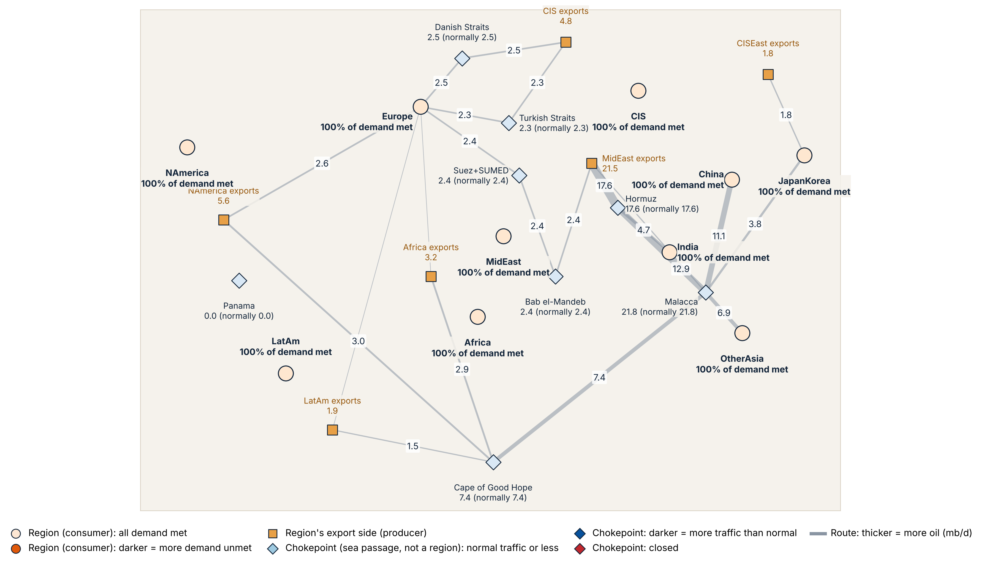
The world's oil trade as a network
LAYER 1 · THE NETWORK
0%
of Hormuz closed
10 regions
11 producers (6 export)
8 chokepoints
37 routes
Every region 100% supplied
Line width = oil flow (mb/d) · Data: EIA, Energy Institute · CITS4403 · 6
Notes:
This is Layer 1 with Hormuz fully open. Circles are regions that use oil, squares are exporters, diamonds are chokepoints, and line thickness is the oil flow. There are 10 regions, 11 producers of which 6 export, 8 chokepoints and 37 routes. Normally Hormuz carries 17.6 million barrels a day in my model and Malacca about 22, and every region gets all the oil it needs. Watch the thick Gulf-to-Asia line through Hormuz as I close it over the next slides.

Slide 7
Simple rules, applied every day
HOW ONE DAY WORKS
Routing
Market
Production
1. Use your own oil first
1. A short region draws its own reserve
1. Each industry is limited by its own oil or its suppliers, whichever is worse
2. Contract cargoes take the fastest open route
2. One price is set so that demand equals the oil available
3. Spot cargoes go to the most desperate buyer
2. Below about 45% of inputs it shuts down
Systemic = a region loses more than 10% of its output. The threshold is the smallest closure that makes any region systemic.
CITS4403 · 7
Notes:
Each day follows simple rules. Routing: a region uses its own oil first, contracted cargoes take the fastest open route, and spot cargoes go to whoever is shortest of oil. Market: a short region draws on its own reserve, then one price is found where demand matches the oil available. Production: each industry is held back by its own oil or by its suppliers, whichever is worse, and below about 45% of inputs it can't run at all. I call a region systemic when it loses more than 10% of its output, and the threshold is the smallest closure where any region gets there. I find it by bisection: halving the range twelve times.

Slide 8
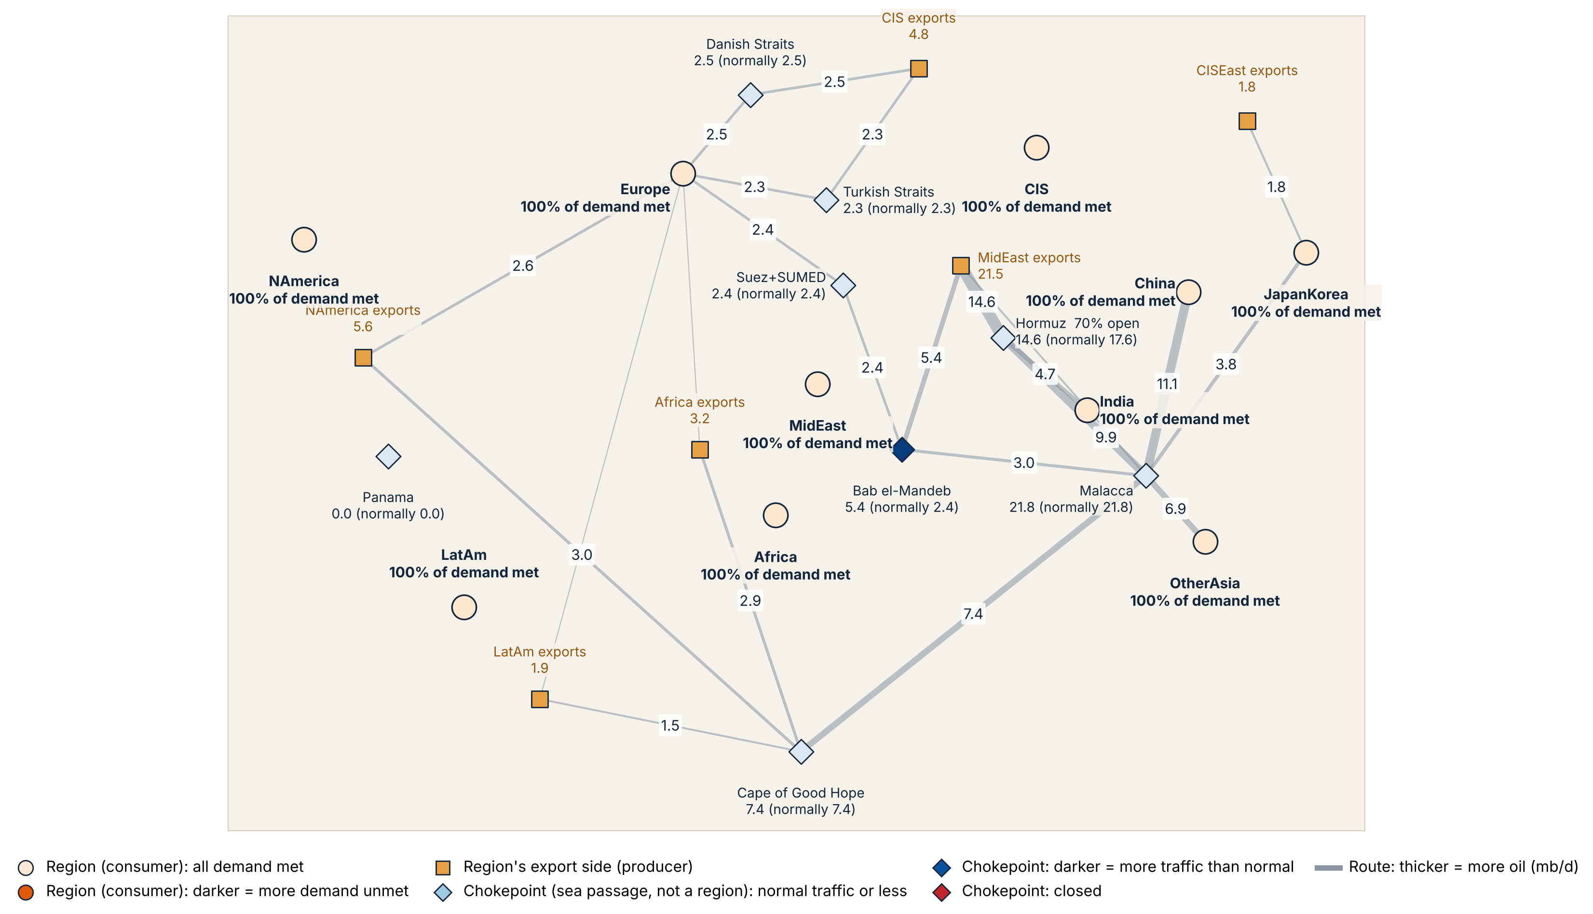
At 30%, the bypasses absorb it
CLOSING HORMUZ · STEP 1
30%
of Hormuz closed
Hormuz 17.6 → 14.6
Saudi pipeline sends more through Bab el-Mandeb: 2.4 → 5.4
No shortage anywhere
Flows in mb/d · CITS4403 · 8
Notes:
Now 30% of Hormuz is closed. Hormuz drops from 17.6 to 14.6, and the oil that can't get through goes round it: the Saudi pipeline takes it to the Red Sea, so the line through Bab el-Mandeb thickens from 2.4 to 5.4. Nobody is short yet. The bypasses absorb the whole closure.

Slide 9
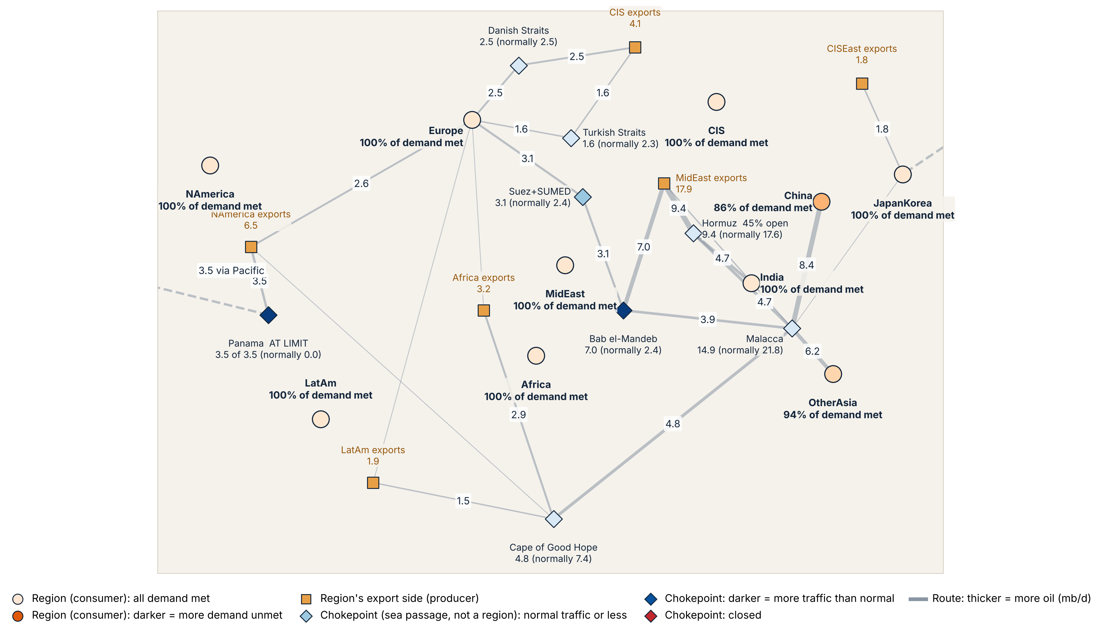
At 55%, the bypasses are full and Asia runs short
CLOSING HORMUZ · STEP 2
55%
of Hormuz closed — just past the 53% threshold
Saudi pipeline full: 7.0
Panama full: 3.5 across the Pacific
China 86%, Other Asia 94% of demand met
Flows in mb/d · CITS4403 · 9
Notes:
At 55%, just past the threshold, the escape routes are full. The Saudi pipeline is at its 7 million barrel limit, and North American oil is crossing the Pacific through Panama, which is also full. There's nowhere left for the oil to go, so for the first time regions run short: China gets 86% of its oil and Other Asia 94%. China is the region that tips over the 10% loss line here.

Slide 10
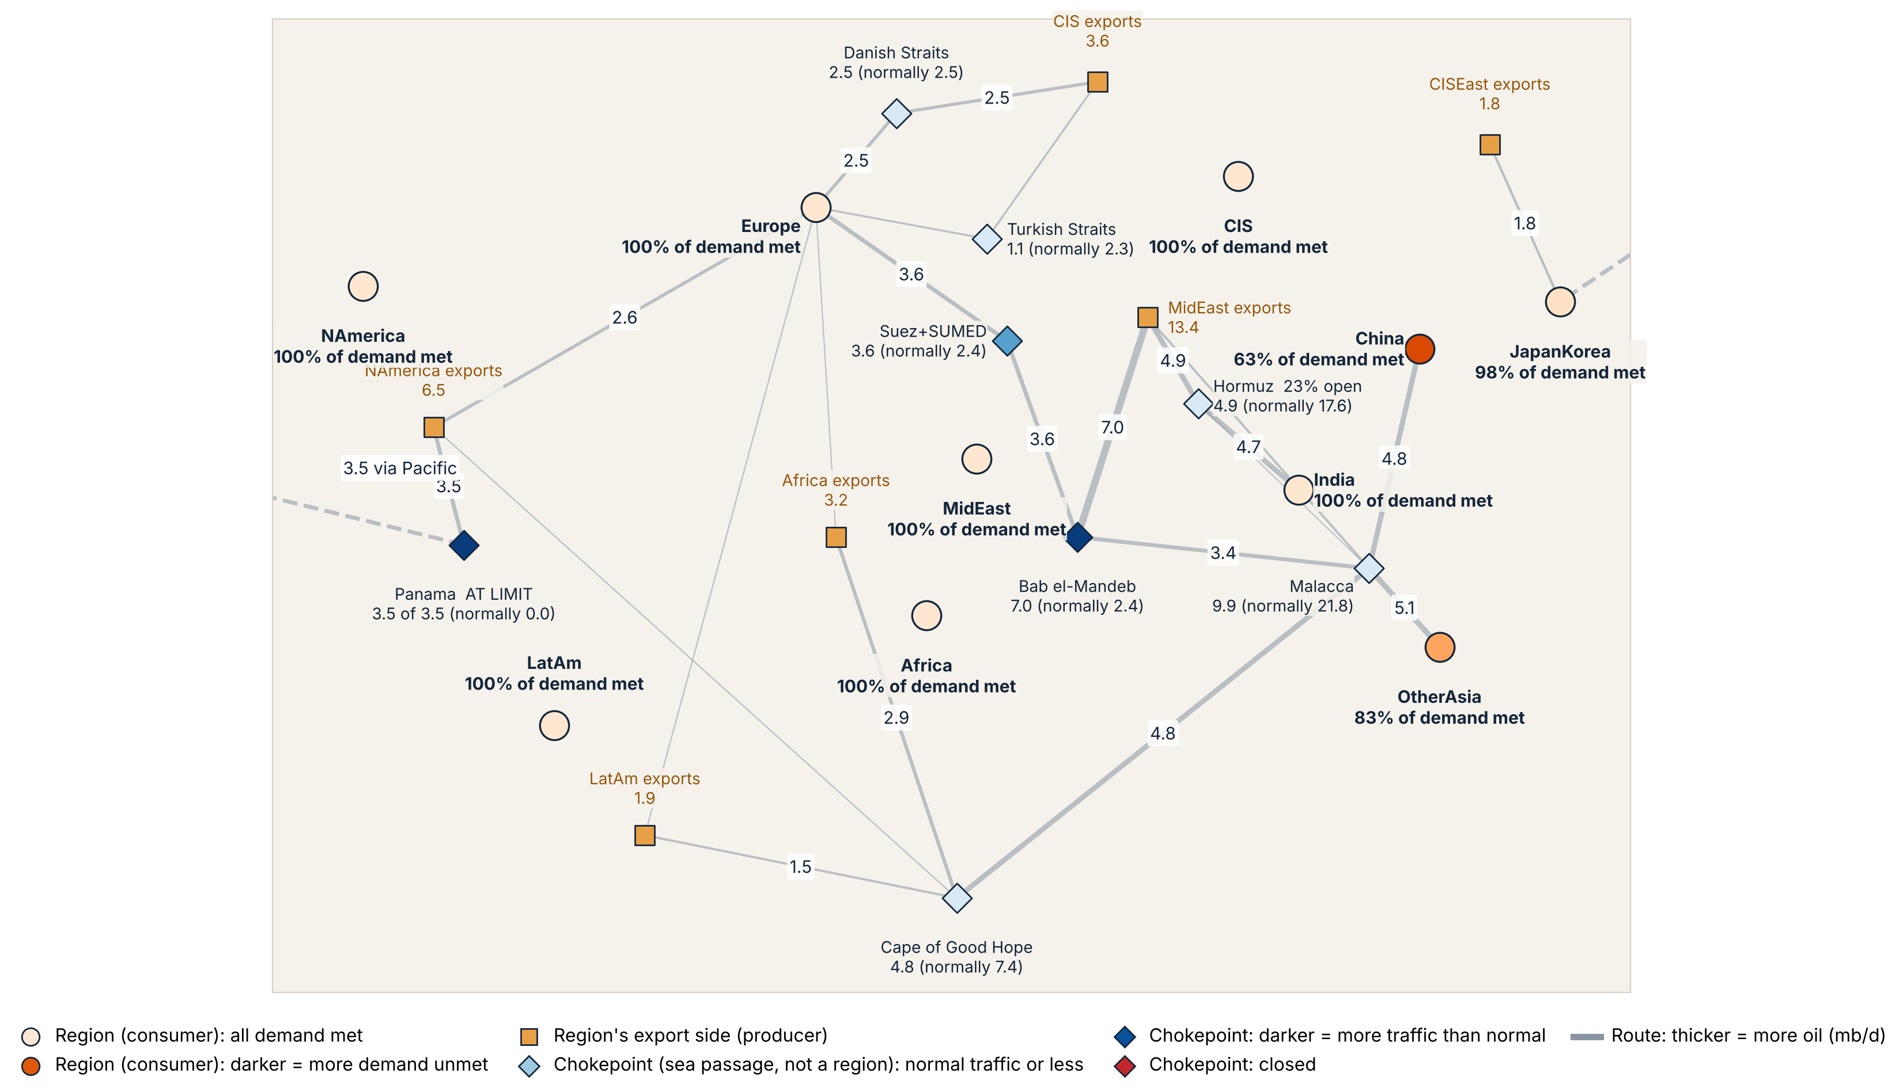
At 77%, China gets under two-thirds of its oil
CLOSING HORMUZ · STEP 3 · THE REAL Q2 2026
77%
of Hormuz closed, as observed in Q2 2026
Hormuz 4.9 (real value)
China 63%, Other Asia 83%
World shortage 7.8
Flows in mb/d, before reserves · CITS4403 · 10
Notes:
This is the real situation in the second quarter of 2026: 77% closed, only 4.9 million barrels a day through Hormuz. The Gulf-to-Asia line that was the thickest on the map is now thin. China gets only 63% of its oil and Other Asia 83%, while Europe, India and North America are still fully supplied. In total the world is 7.8 short before any reserves are used. India keeps its oil because Gulf-to-India is the shortest voyage, so it's filled first.

Slide 11
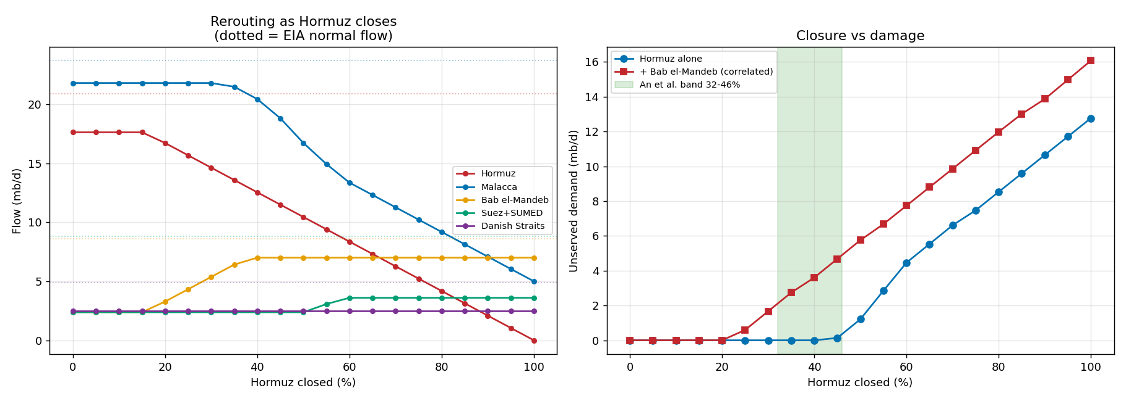
Yes — at 53% of Hormuz closed
Q1 · IS THERE A TIPPING POINT?
Up to ~45% the bypass pipelines absorb the closure; after that the shortage climbs fast and falls on China and Other Asia.
Robust: 52.6–53.1% as the shutdown level moves from 30% to 60% · CITS4403 · 11
Notes:
Answer to Q1: yes. Left chart: as Hormuz closes, the Saudi pipeline fills and Bab el-Mandeb traffic rises to 7, its limit, by 40%. Right chart, blue line: almost no shortage until about 45%, because the bypasses absorb it, then it rises steeply to 12.8 million barrels a day at full closure. The first region to lose more than 10% of its output is China, at 53.1% closed. That's the threshold. It hardly moves if I change my assumed shutdown level from 30% to 60%. The red line is the next question.

Slide 12
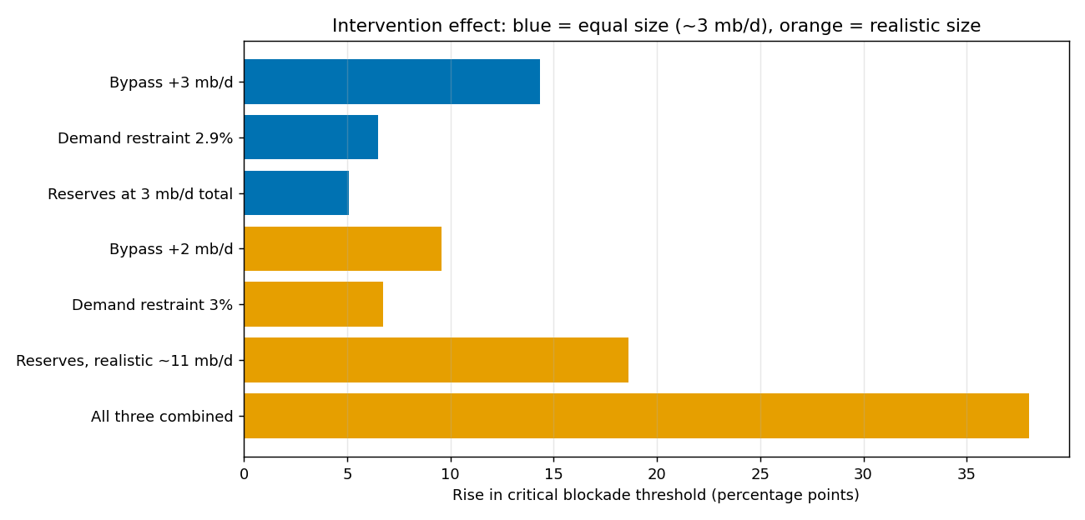
Pipelines win per barrel; reserves win only for a while
Q2 · WHICH FIX WORKS BEST?
Same size (~3 mb/d each)
Bypass +14 · Use less +7 · Reserves +5
Realistic size
Reserves +19 (until they run out) · Bypass +10 · Use less +7
All three together: +38 points
Points = rise in the threshold above 53% · CITS4403 · 12
Notes:
Q2 compares three fixes in two ways. Blue bars give each fix the same 3 million barrels a day, a fair per-barrel race: extra Saudi pipeline capacity raises the threshold by 14 points, using 2.9% less oil by 7, reserves by 5. Pipelines win because they free real Gulf oil that can go wherever it's needed, while reserves stay in the country that owns them. Orange bars use realistic sizes: reserves give the biggest jump, 19 points, but only until they run out; at 71% closure China's reserve runs dry on day 350 and it turns systemic the next day. All three together add 38 points. Reserves buy time; pipelines buy resilience.

Slide 13
The safety valve is also the weak spot
Q3 AND Q4
Q3 · A second strait closes
Q4 · Where reserves sit
+49%
$151 vs $81
more shortage at 70% closure when Bab el-Mandeb also shuts (6.6 → 9.9 mb/d). The main bypass pipeline exits through it.
Brent on day 100 of a full closure: regional reserves vs one shared pool ($236 with none). About 500 Mb in the US, Europe and India is never used.
CITS4403 · 13
Notes:
Q3: if Bab el-Mandeb closes too, the shortage at 70% Hormuz closure goes up by about half, from 6.6 to 9.9. That's because the Saudi pipeline, the main way around Hormuz, comes out on the Red Sea and has to pass Bab el-Mandeb. So the bigger the bypass, the more we depend on that second strait. Q4: at full closure, day 100, the price is $236 with no reserves, $151 with real regional reserves, but $81 if all reserves could be pooled. The difference is location: the US, Europe and India aren't short, so about 500 million barrels sit unused while China runs out.

Slide 14
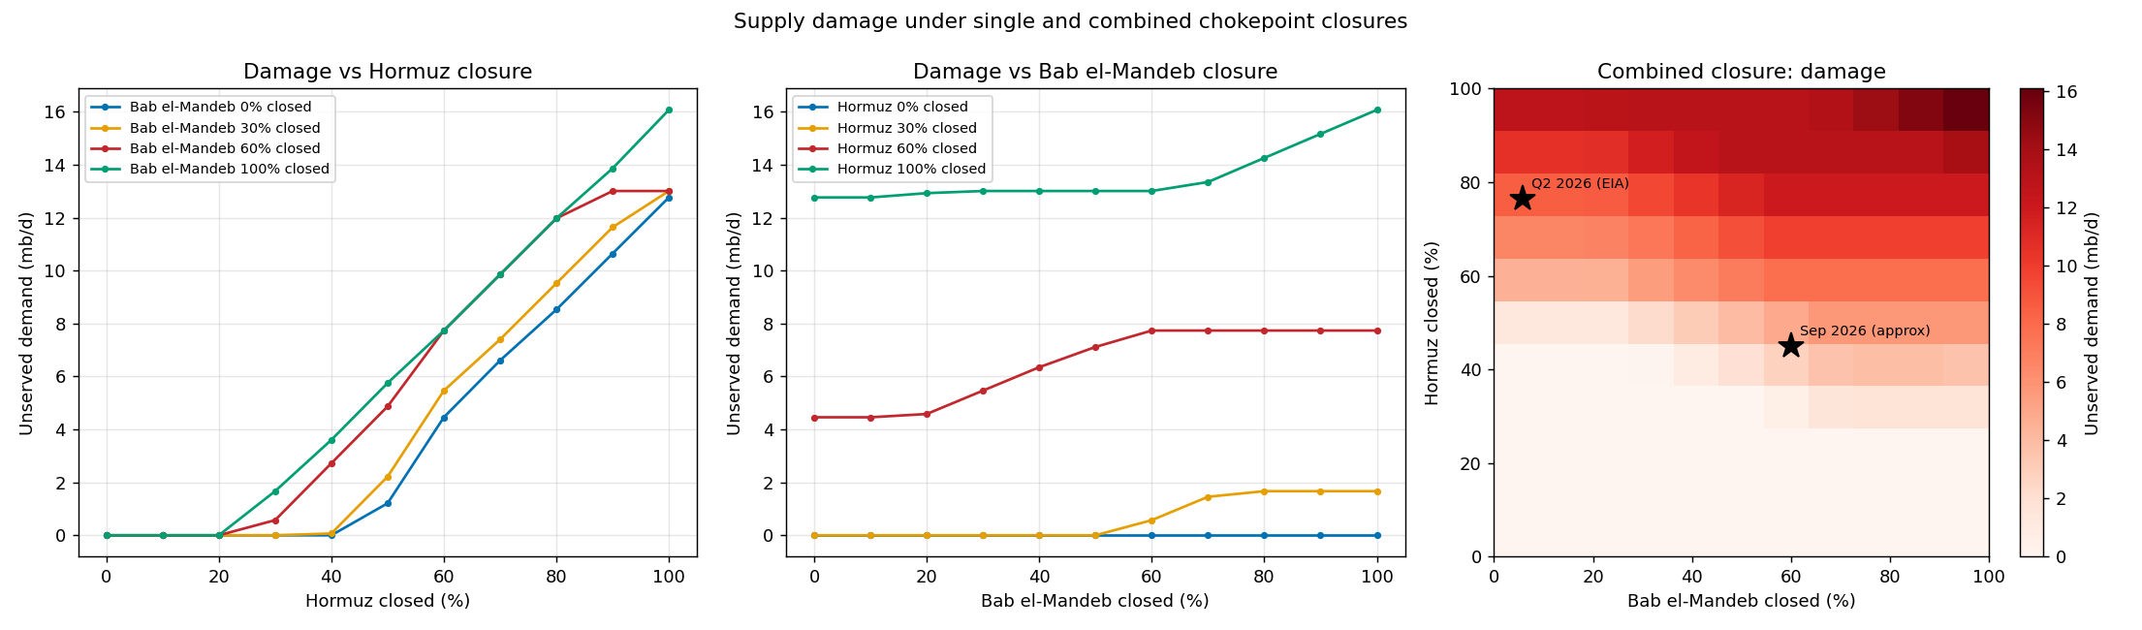
Supply damage under single and combined closures
Q3 · ONE STRAIT OR TWO
Hormuz drives the damage: Bab el-Mandeb closed on its own does nothing (blue line, middle).
Together they compound: both fully closed = 16.1 mb/d short, vs 12.8 for Hormuz alone (darkest corner).
121 runs: every 10% step of each strait · stars = real 2026 situations · CITS4403 · 14
Notes:
This is the full Q3 experiment: 121 runs, every combination of the two straits in 10% steps. Left: damage as Hormuz closes, one line per Bab el-Mandeb level; the more Bab el-Mandeb is closed, the earlier damage starts. Middle: the other way round; with Hormuz open, closing Bab el-Mandeb does nothing at all, the blue line stays at zero. Right: the heat map of both, darker means more oil missing. The darkest corner, both fully closed, is 16.1 million barrels a day short against 12.8 for Hormuz alone. The stars are the real 2026 situations: Q2 with Hormuz 77% closed, and an approximate September point with the Red Sea route impaired.

Slide 15
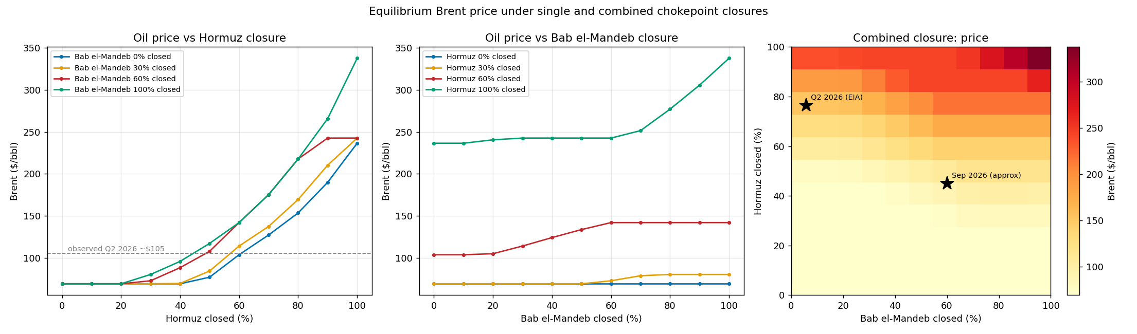
Equilibrium Brent price under the same closures
Q3 · THE PRICE
Price rises faster than the shortage: Hormuz fully closed ≈ $236; both straits closed ≈ $338.
No reserves in these runs: at the Q2 2026 star the model gives $143; with reserves $94; observed ≈ $105.
Price from Layer 2 (one world price, constant-elasticity demand) · CITS4403 · 15
Notes:
Same 121 runs, but now the price from Layer 2. The pattern matches the damage, but the price curves bend upward more steeply, because short-run demand barely responds to price, so each extra missing barrel pushes the price up more than the last. Hormuz fully closed gives about $236; both straits fully closed about $338. These runs have no reserves, so they show the pure pressure on the market. At the real Q2 2026 point the model gives $143 without reserves and $94 with them; the observed $105 sits in between, which is my best validation because nothing about price is set from data.

Slide 16
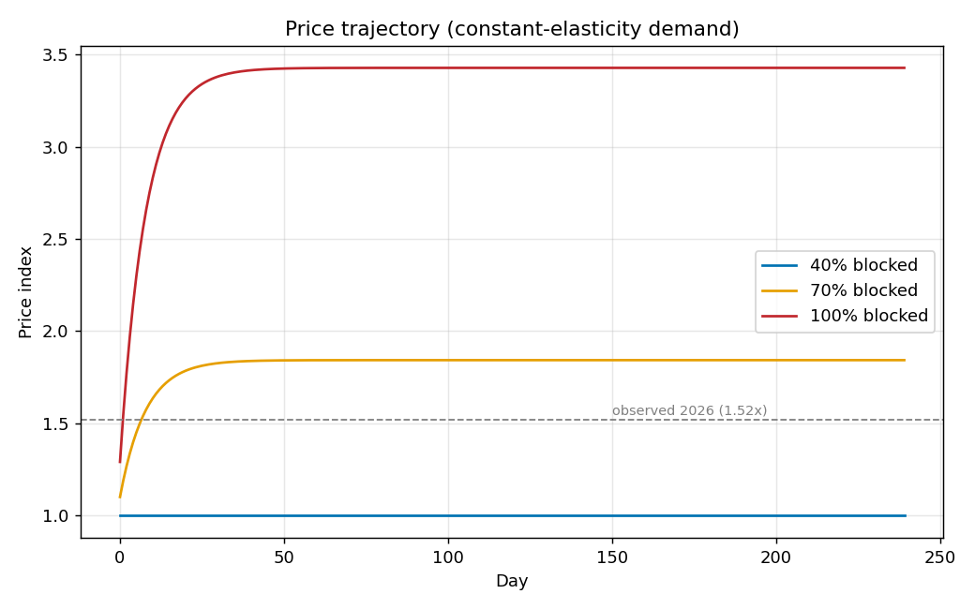
The price climbs for a month, then levels off
PRICE OVER TIME · NO RESERVES
Price index 1.0 = $69
40% closed → $69 (no change)
70% closed → ≈ $127
100% closed → ≈ $236
Each day the price moves 12% of the way to the level where demand equals the oil available.
price_dynamics.py · dashed line = observed 2026 ($105) · CITS4403 · 16
Notes:
This is price_dynamics.py: the price day by day with no reserves, at three closure levels. The price index is 1 at $69. At 40% closed nothing happens, because the bypasses absorb it. At 70% the price settles near 1.84, about $127, and at full closure near 3.42, about $236. It takes about a month to get there, because each day the price only moves 12% of the way to the level that balances demand with the oil available. The dashed line is the real 2026 level, $105.

Slide 17
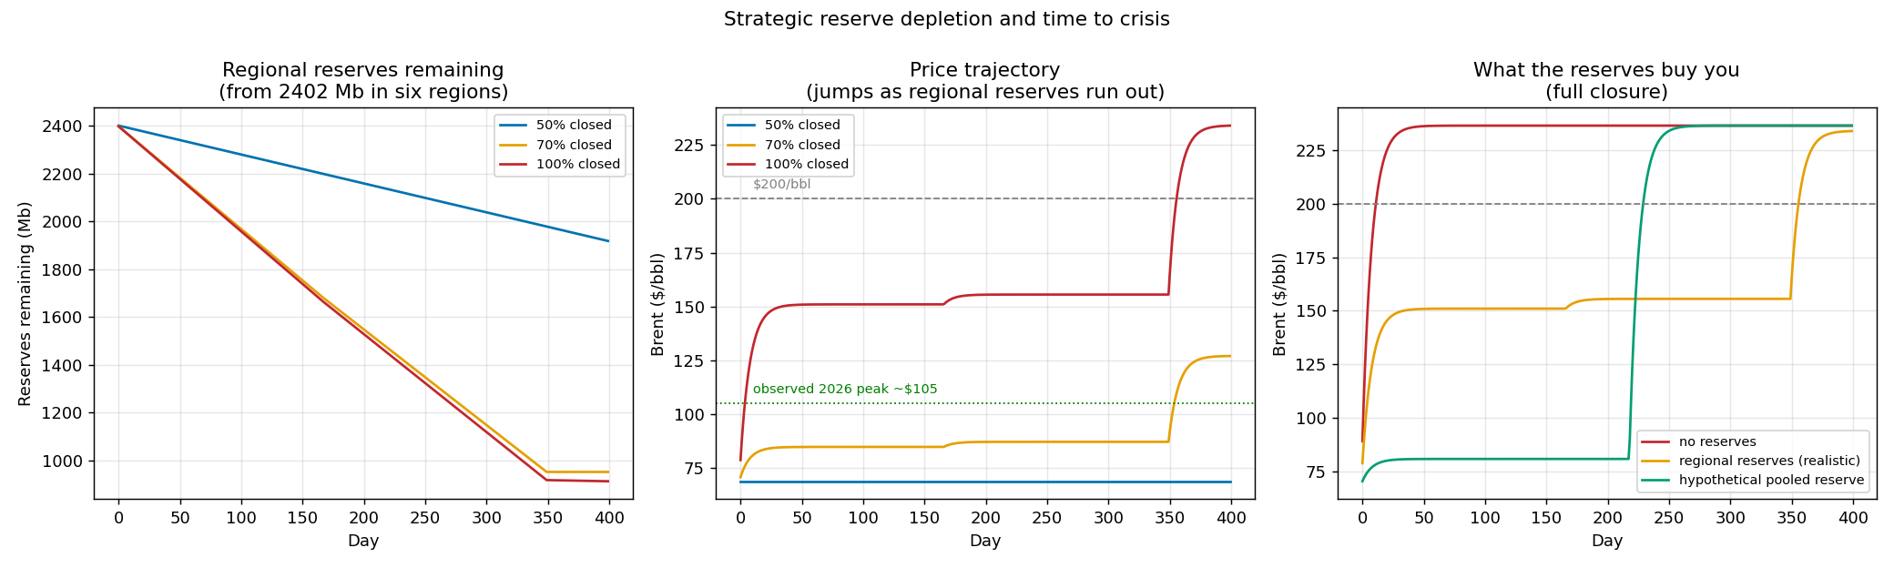
Reserves cushion the price, then run out
Q4 · STRATEGIC RESERVES OVER TIME
Centre: the price jumps when a region's reserve runs out — Other Asia near day 167, China on day 350.
Right, full closure: no reserves $236 · regional $151 · one shared pool $81.
spr_depletion.py · 2,402 Mb in six regions · CITS4403 · 17
Notes:
This is spr_depletion.py over 400 days. Left: total reserves going down; at full closure they stop falling around day 350, with about 900 million barrels still left, because the regions that hold them are not short. Centre: the price with realistic regional reserves; it steps up each time a region runs out, Other Asia around day 167 and China on day 350, after which it jumps to the no-reserve level. Right: at full closure, no reserves gives $236, regional reserves $151, and one shared pool $81. The pool helps far more but, because it is all used, it also runs out sooner, around day 220.

Slide 18
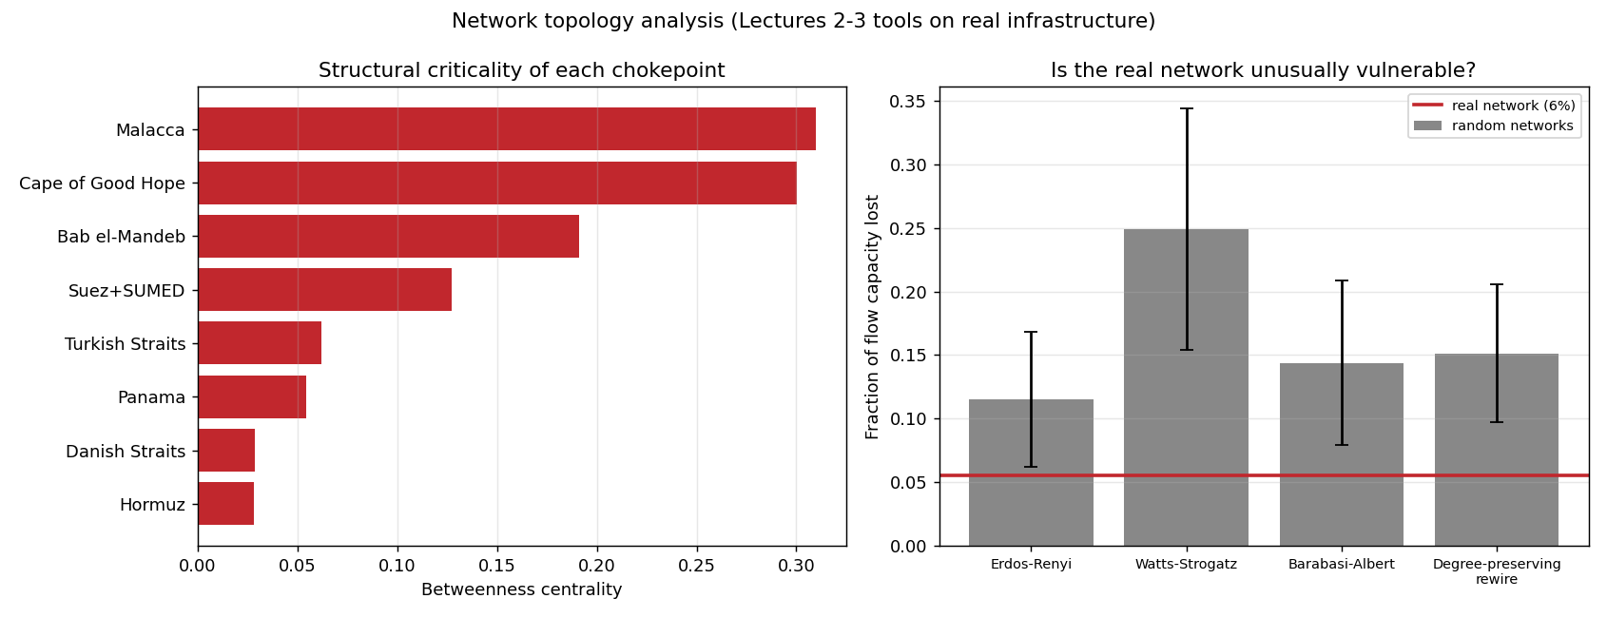
The shape is robust; the problem is volume
Q5 · SHAPE OR CAPACITY?
By betweenness, Hormuz looks least important (0.03) — it serves one exporter that has other exits.
The real network loses 5.6% of capacity vs 12–24% for Erdős–Rényi, Watts–Strogatz, Barabási–Albert and rewired graphs.
200 random graphs of each type, same 22 nodes and 39 edges · CITS4403 · 18
Notes:
Q5 uses the tools from lectures 2 and 3. For this I redraw the routes as a plain graph: 22 nodes and 39 edges. Betweenness says Hormuz is almost the least important node, because only one exporter uses it and that exporter has other ways out. And compared with 200 random graphs of each taught type with the same size, the real network is the most robust: it loses 5.6% of capacity when its most central node goes, against 12 to 24%. So the shape isn't the problem. Hormuz matters because of how much oil it carries, which is why I needed a flow model, not just topology.

Slide 19
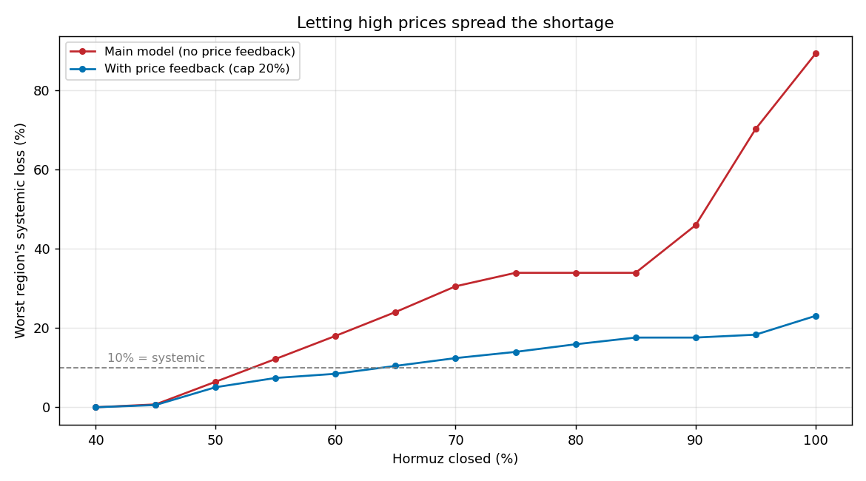
When prices spread the pain, the threshold rises to 64%
Q6 · EXTENSION: PRICE FEEDBACK
High price → every region buys up to 20% less → that oil is re-routed to others.
Worst loss at full closure: 89% → 23%
Takes about a month: 53% is the first weeks, 64% once markets adjust.
Cap tested at 10, 20, 30%: threshold 69.1, 63.9, 63.9% · CITS4403 · 19
Notes:
My extension closes the loop that An et al. left for future work. Each day, high prices make every region buy less, by at most 20%, and the oil they stop buying goes back into the routing for others. With that, the threshold rises from 53 to 64%, and the worst region's loss at full closure falls from 89% to 23%, because the shortage is shared by everyone instead of dumped on Asia. It takes about a month for prices to do this, so 53% describes the first weeks of a closure and 64% describes it once markets adjust. The 20% cap is an assumption; 30% gives the same answer.

Slide 20
Right direction, honest limits
IS IT RIGHT?
Checked against 2026
Limits
Price: model gives $94–$143 (with / without reserves); real Brent was ~$105 — inside the range.
Simple greedy routing, not a full market
No refined products or crude grades
Rerouting goes the right way but is too small: Bab el-Mandeb 7.0 vs 8.1, Malacca 9.9 vs 16.6 mb/d.
Some parameters assumed; the threshold is an estimate (38–56% across model versions)
CITS4403 · 20
Notes:
Is it right? The best check is price, because nothing about price is set from data: at the real Q2 2026 closure the model gives $94 with reserves and $143 without, and the real price, about $105, sits in between. Rerouting goes the right way but is smaller than observed, mostly because I don't model refined products. Limits: routing is a simple greedy rule, not a full market; no product types; several parameters are my assumptions. The threshold is insensitive to those parameters but moved between 38 and 56% as I fixed errors in the model's structure, so I treat 53% as this model's estimate, not a fact about the world.

Slide 21
Six questions, six answers
THE ANSWERS
Q1 | Yes: a region turns systemic at 53% of Hormuz closed
Q2 | Per barrel, bypass pipelines; at full scale, reserves — but only until they run out
Q3 | Yes: closing Bab el-Mandeb too adds 49%, because the bypass runs through it
Q4 | Yes: pooled reserves would hold the price near $81 instead of $151
Q5 | Capacity: the network's shape is more robust than random graphs
Q6 | Letting prices share the shortage raises the threshold to 64%
Generative AI (Claude) assisted with code and drafting; the question, modelling decisions and error review are my own · 21
Notes:
To sum up. Q1: there is a tipping point at about 53% closure. Q2: per barrel, bypass pipelines are the best fix; at realistic scale reserves help most but run out. Q3: a second closure at Bab el-Mandeb makes it about half again worse, because the main bypass goes through it. Q4: reserves are in the wrong place; pooling them would roughly halve the price. Q5: the problem is how much oil goes through a few points, not the network's shape. Q6: once prices spread the shortage, the threshold rises to 64%. Thank you; happy to take questions.

